Slide 1
Modern Application and API development
Module – 01
Class-06
CSS-02
Saylani Mass IT Training Faisalabad

Slide 2
Selectors
Attribute Selector tagname[attribute]{ }
Attribute start with ^= (wedge symbol)
Attribute end with $=
Attribute contain words ~= (tilde symbol)

Slide 3
Selectors
Multiple Selector h1,p,button { }
Parent Child selector #id p { } , #id > p {}
Select immediate after the tag h1+p {}
Select immediate before the tag p ~ h4 {}

Slide 4
Pseudo-classes
A pseudo-class is used to define a special state of an element.
For example, it can be used to:
Style an element when a user mouses over it
Style visited and unvisited links differently
Style an element when it gets focus
a:link {}
a:hover {}
a:active{}
a:visited{}

Slide 5
Pseudo-classes
a:link {}
a:hover {}
a:active{}
a:visited{}
Input[type=“checkbox”]:checked{ outline }
Input[type=“text”]: disabled{}
Input[type=“text”]: focous{}
p:nth-child() {}

Slide 6
Pseudo-Elements
A CSS pseudo-element is used to style specified parts of an element.
For example, it can be used to:
Style the first letter, or line, of an element
Insert content before, or after, the content of an element
#paragraph::first-letter{} #paragraph::first-line{}
#paragraph::selection{}
.class::before{Content : “” }
.class:: after{Content : “” }
Understand The CSS

Slide 7
Understanding CSS
Top to Bottom
Inline , Internal , External
Overriding The style
ul li a
.ul li a
#a
Id is stronger then class Body with id and class
! important

Slide 8
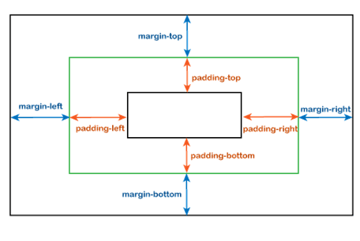
Padding and Margin

Slide 9
Padding
Padding is used to create space around an element's content, inside of any defined borders.
Padding-top
Padding-right
Padding-bottom
Padding-left

Slide 10
Margin
Margin used to create space around an element's , outside of any defined borders.
Margin -top
Margin -right
Margin -bottom
Margin -left

Slide 11
Border
The CSS border properties allow you to specify the style, width, and color of an element's border.
Border(width ,color , style)
Clockwise: top right bottom left
Border Radius (top ,right ,bottom , left)

